Slide 1
GENLITE POWER AND RENEWABLES LTD ENERGY EFFICIENCY & RENEWABLE ENERGY EXPERTS
COMPANY PROFILE

Slide 2
MISSION AND VISION
Offer our customers high value electrical and renewable energy solutions through our expertise in design, installation, testing and commissioning
To offer quality energy studies/Audits, Renewable Energy Solutions of choice and first Class Electrical Power Installations

Slide 3
ABOUT US:
Genlite Power & Renewables Ltd (GPRL), a private incorporated company in Kenya in 2016, is an Electrical Engineering Company involved in Energy Efficiency, Renewable Energy and Electrical installations.
GPRL is licensed by Energy and Petroleum Regulatory Authority of Kenya (EPRA) under the following categories;
EPRA Class A energy Auditors
Solar Photovoltaic Installation – EPRA Class V1 & V2
Electrical Installations - Class B Electrical Contractors
Solar water Heating Installations

Slide 4
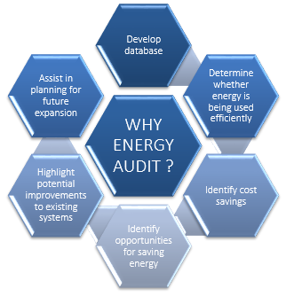
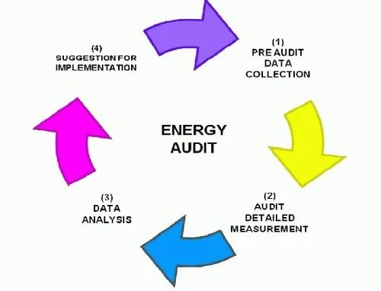
OUR CORE BUSINESS:
ENERGY AUDITING & MANAGEMENT
We Conduct Energy Audits for Electrical, Thermal, HVAC and Compressor Systems.
The Goal of Our Audits is to;
ELECTRICAL SAFETY AUDIT (ESA)
This Study helps Identify potential electrical hazards to prevent or minimize loss of life and property. Latest study shows around 8% of all fatalities in factories are due to accidents caused by electricity and which could be avoided.
Environmental Sustainability.
Reduce the Energy cost Component in the final finished Product.
Statutory Compliance

Slide 5
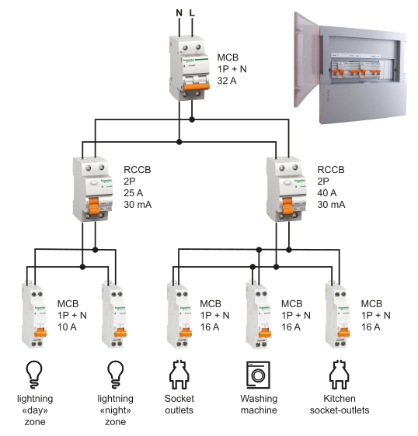
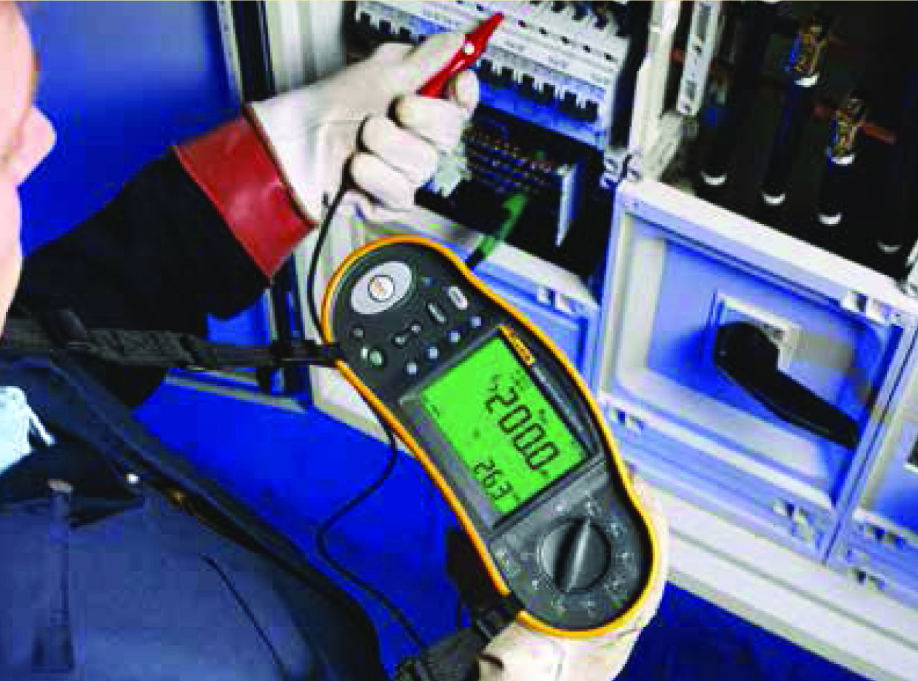
OUR CORE BUSINESS CONT.
ELECTRICAL ENGINEERING INSTALLATIONS
Medium and Low Voltage electrical installations for both domestic, Commercial and industrial premises
Low Voltage switchgear, Transformer, Automatic Voltage Regulator, Low Voltage & Uninterruptible Power Supplies (UPS) installations
RENEWABLE ENERGY INSTALLATIONS
Hybrid, On grid and off grid solar photovoltaic (PV) installations with and without storage.
Thermos phonic and central solar thermal installations.
Renewable Energy Feasibility Studies.

Slide 6
WHY US:
We understand facilities and we understand energy. We combine these two areas of expertise to form our core competence of unmatched quality, compliant, safe electrical & energy efficiency installations. As your electrical and energy efficiency Partner, we offer integrated and intelligent solutions to ensure your goals at optimal price.
Our Resources and Strengths include;
We are licensed by Energy and Petroleum Regulatory Authority (EPRA)
EPRA Accredited and Licensed Workers.
Latest instrumentation to ensure accurate measurements and improved/enhanced safety.
Wide and Client reference base and references.
Accomplished in latest BIM (Revit and Auto cad) design and drafting software.
Dedicated in ensuring economic, environmental and social sustainability of our installations.

Slide 7
Our Experience: – Select Energy Audit Projects
S/N | Facility | Type of Energy Audit | Period | Contact Person
1 | Mambo Italia Restaurant Westlands | General Energy Audit (GA) | 2024 | Mr. Alex Tel: 0708 197 569 Email: hr@mambo-italia.com
2 | Southern Engineering Constrcution Company Ltd (SECO) | Investiment Grade Energy Audit (IGA) | 2020 & 2022 | Mr. Edgar Matiga Tel: 0716 588 881 Email: wm.sssl@alphakenya.com
3 | Southern Shipping Services Company (SSSL) | Investiment Grade Energy Audit (IGA) | 2020 & 2022 | Mr. Edgar Matiga Tel: 0716 588 881 Email: wm.sssl@alphakenya.com
4 | BOC Kenya Ltd | Investiment Grade Energy Audit (IGA) | 2020 | Mrs Ritah Ndonye Tel: 0722 706 720 Email: rita@ioshem.co.ke
5 | Naivas Supermarkets Ltd (71 Braches In Kenya) | Investiment Grade Energy Audit (IGA) | 2020 / 2021 | Ms Beatrice Karanja Tel: 0711 175 131 Email: beatrice.karanja@naivas.co.ke
7 | Adlife Plaza Kilimani | Investiment Grade Energy Audit (IGA) | 2019 | Evans Kibiru Tel: 0720 279 469
6 | African Population Health and Research Centre (APHRC) | Investiment Grade Energy Audit (IGA) | 2018 | Erick Masanta Tel: 0723 770 959
8 | Razco (lyonsmaid) Ltd | Investiment Grade Energy Audit (IGA) | 2018 | Mr. Hasnain Tel: 0788786111
9 | The Nairobi Hospital | Investiment Grade Energy Audit (IGA) | 2019 | Stephen Muthengi Tel: 0716 647 146 Email: munyaosteven@gmail.com

Slide 8
Our Experience: – Select Solar Projects
S/N | CLIENT | PROJECT LOCATION | PROJECT DESCRIPTION | STATUS
1 | St. Mary's School Lavington | Naiorbi - Lavington | Supply, Installation, Testing and Commissioning of 75kW Grid Tie Solar Photovoltaic System | Completed in February 2024
2 | World Vision Kenya Ltd | World Vision East Africa Regional Offices Karen, Nairobi | Supply, Installation, Testing and Commissioning of 100 kW Grid Tie Solar Photovoltaic System | Completed in Nov. 2023
3 | Archidiocese of Nairobi - Holy Family Minor Basilica | Holy Family Minor Basilica Nairobi CBD | Supply, Installation, Testing and Commissioning of 100 kW Grid Tie Solar Photovoltaic System | Completed in Oct. 2022
4 | ABSA Bank Kenya Limited | ABSA Towers along loita street Nairobi Business District | Supply, Installation, Testing and Commissioning of 30 kW Grid Tie Solar Photovoltaic System | Completed in June . 2021

Slide 9
Our Experience: Select Other Projects
S/N | CLIENT | PROJECT LOCATION | PROJECT DESCRIPTION | YEAR COMPLETED
1 | Electrical Services for a Residential House | Lower Kabete | General Electrical Installations and Security systems installations | On going
2 |  | Ngara, Nairobi Kenya | Retrofit of 3no. Basements with energy efficient LED water proof battens | June 2022
3 |  | Upper hill in Nairobi Kenya | Installation of 42no. Solar Powered perimeter lights Phase 1 along Ngong road section | Feb. 2021
4 |  | Embu Town | Installation of grid powered Security lights for Embu town | July 2021
5 | Father Kizito Children Home in Rongai | Rongai in Kajiado County | Installation of 25kWp Hybrid solar PV System | July 2019

Slide 10
Managing Director
Technical Lead
Head of Energy Audits and Energy Efficiency
Head of Solar Projects
Admin and Finance
Accountant
Head of Electrical Projects
Energy Audit Engineers (M&E)
Solar Technicians
Electrical Technicians

Slide 11
WE ARE LICENSED BY:
AND MEMBER OF

Slide 12
THANK YOU

